Slide 1
Opticrop: Smart Agricultural production optimization engine
Time size : 5
Team leader : shaik masthan valli
Team members: gangarapu hemaharshini
pj likitha sri
nelakotappagari Tejaswini
Varadaiahgari bhavana

Slide 2
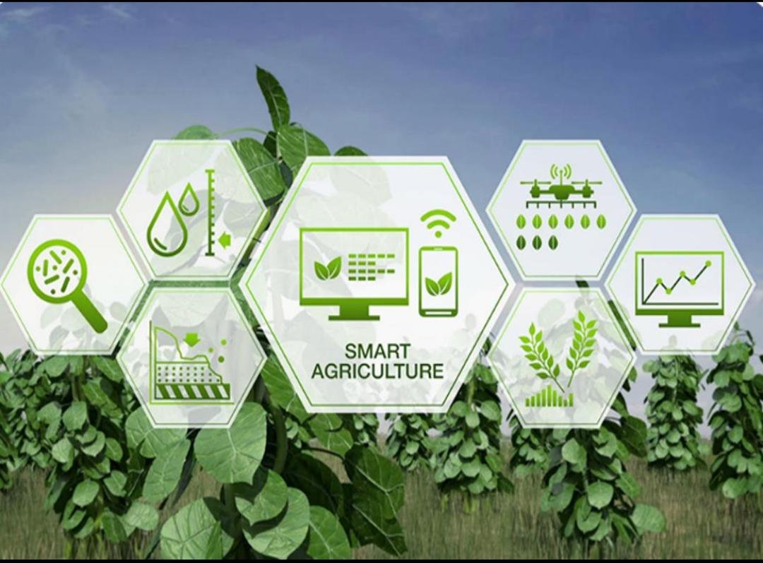
List of the contents
Problem statement
Abstart
Proposed solution
Target users
Sample outcomes
Use cases
How it will work
Summary
Future and conclusion

Slide 3
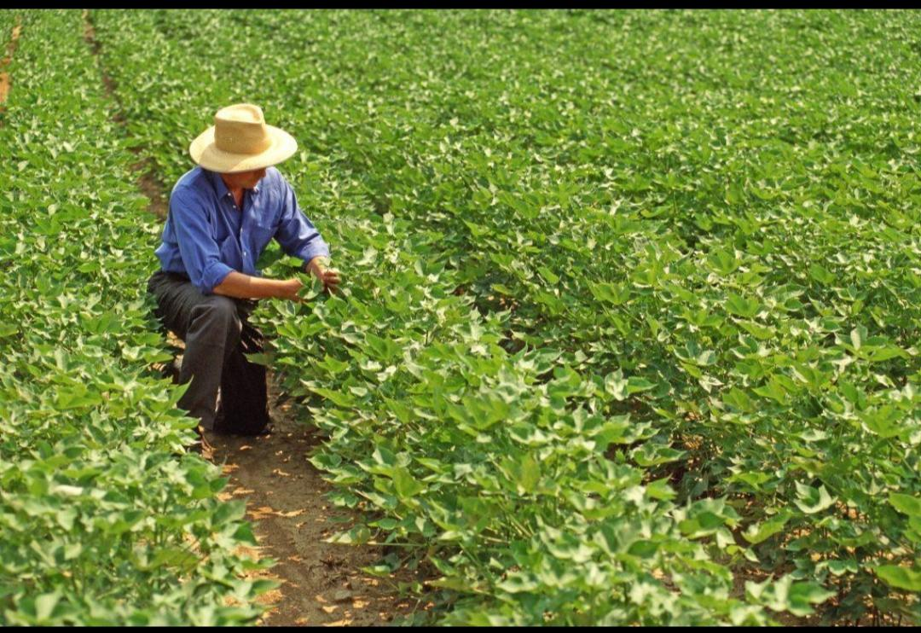
Problem statement
Farmers face difficulties in selecting the right crop for their land. Weather changes can negatively impact crop production. Improper irrigation leads to water wastage and reduced yields. Excessive or insufficient fertilizer usage affects soil health. Lack of real-time farm monitoring delays decision-making. Predicting crop yield accurately is challenging for farmers. There is a need for a smart system to optimize agricultural production.

Slide 4
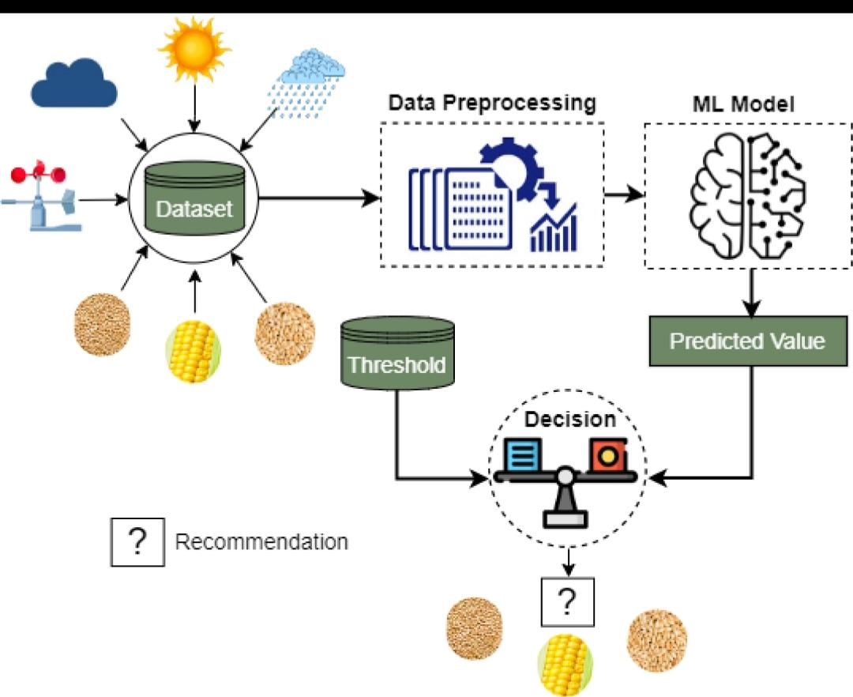
Abstart
OptiCrop is a smart agriculture system that uses AI and Machine Learning to help farmers make better decisions. It analyzes soil, weather, and crop data to provide accurate recommendations. The system optimizes irrigation and fertilizer usage, reduces resource wastage, and predicts crop yield. By offering real-time insights, OptiCrop improves productivity and promotes sustainable farming.

Slide 5
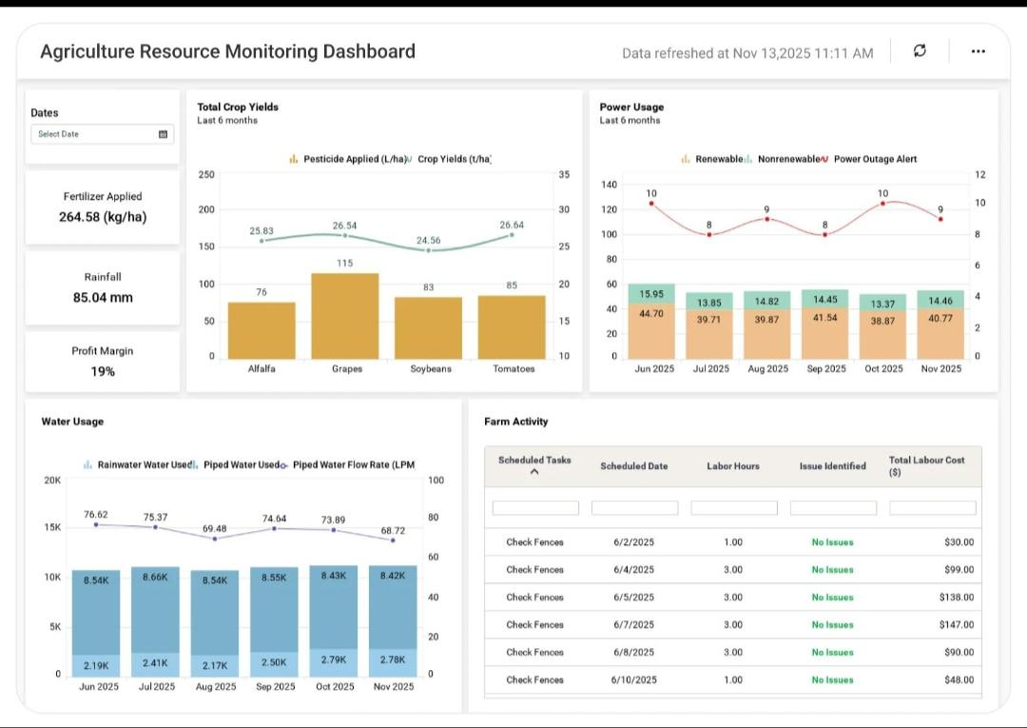
Proposed solution
Weather based farming suggestion:Provides crop recommendations using weather forecasts. Irrigation scheduling:Optimizes watering schedules for efficient water use. Real-time Monitoring:Tracks farm conditions and crop status continuously.

Slide 6
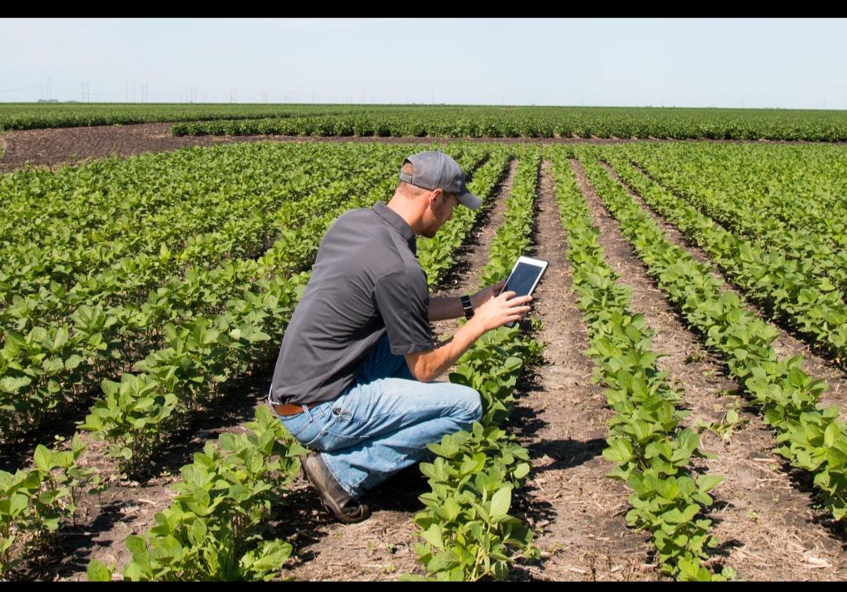
Target users
Farmers: Make better crop and farming decisions. Agriculture consultants:Provide data-driven farming guidance. Research optimization:Analyze data for agricultural innovation. Farm owners: Monitor farm performance and productivity.

Slide 7
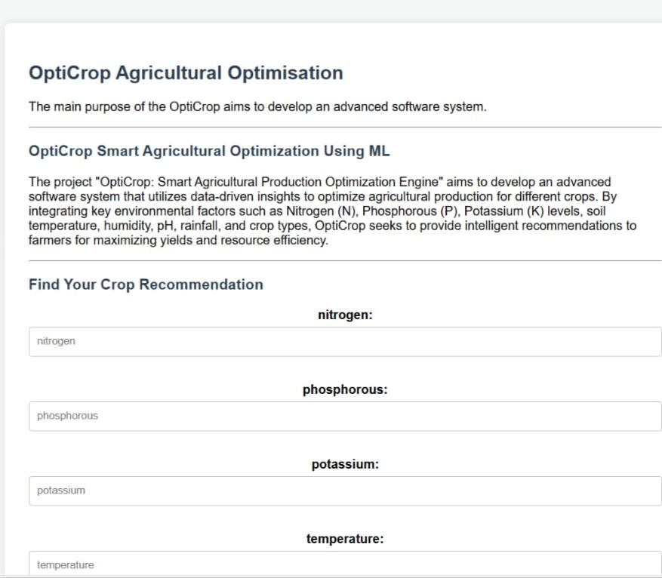
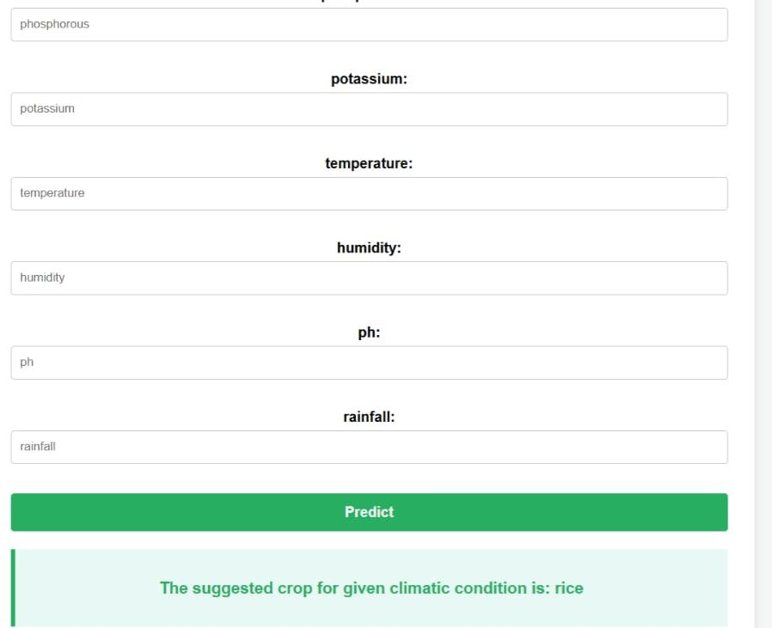
Sample outcomes

Slide 8
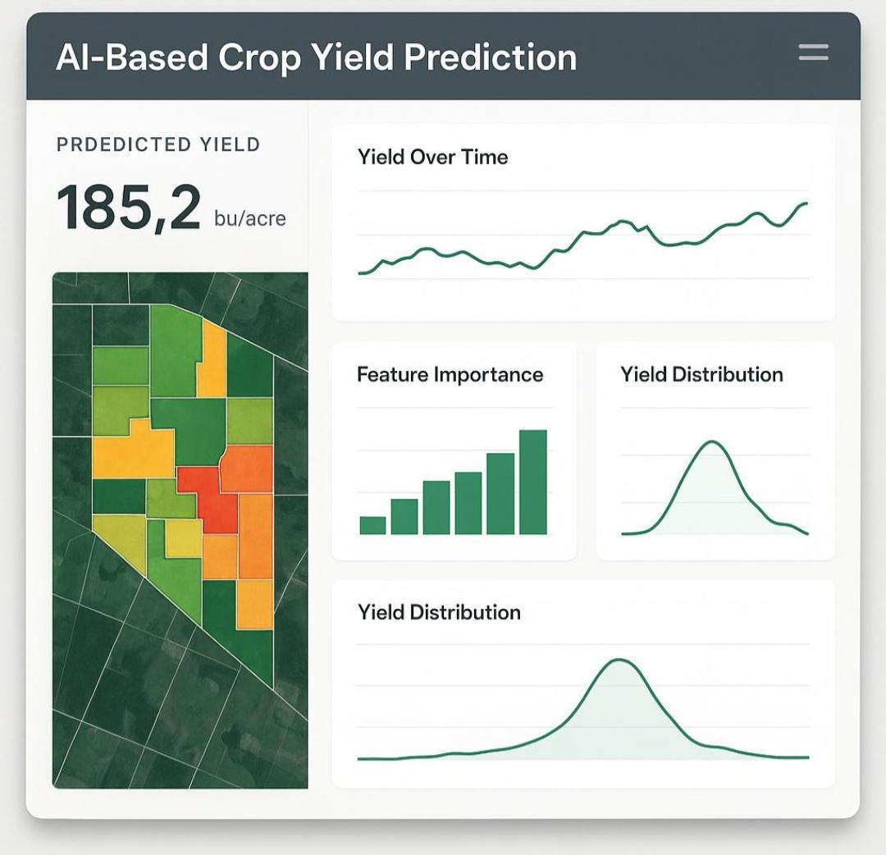
Use cases
Crop Selection Assistance Yield Prediction Smart Irrigation Management Fertilizer Recommendation Weather Risk Assessment Farm Productivity Optimization

Slide 9
How it will work
Farmer enters farm details – Farmers provide information such as soil type, location, and crop preferences. System collects soil and weather data – The system gathers real-time environmental and agricultural data. AI model analyzes information – Artificial Intelligence processes the collected data to identify the best farming strategies. Recommendations are generated – The system provides personalized suggestions for crops, irrigation, and fertilizers. Farmer follows suggestions – Farmers implement the recommended actions to improve farming practices. Production and yield improve – Optimized decisions lead to higher crop productivity and better harvest outcomes.

Slide 10
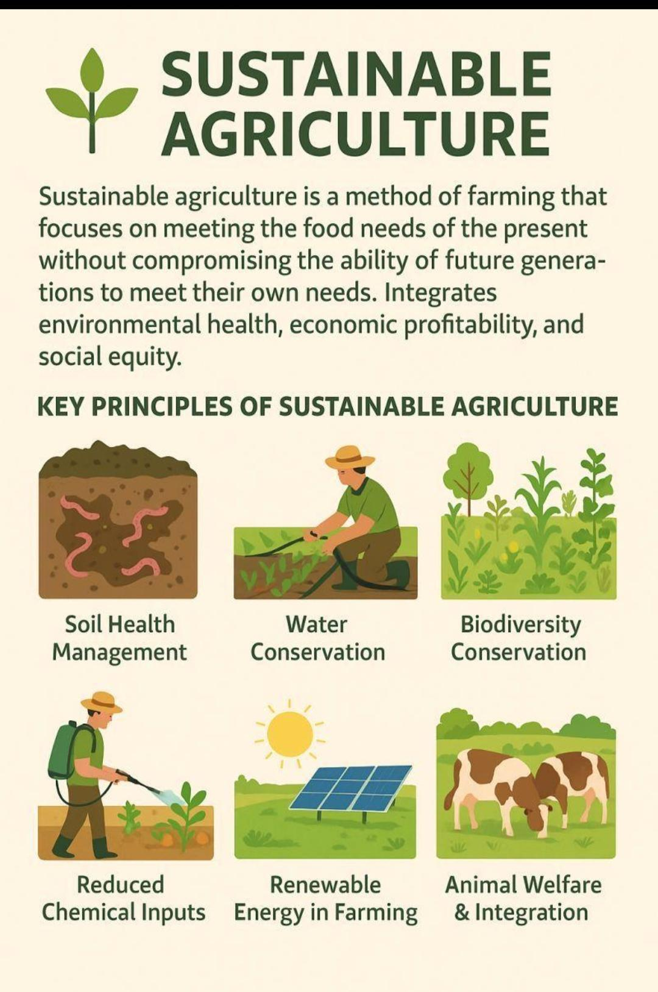
Summary
OptiCrop is a smart agricultural production optimization system that uses AI and Machine Learning to improve farming efficiency. It analyzes soil, weather, and crop data to provide accurate recommendations. The system helps optimize irrigation and fertilizer usage, predicts crop yield, and supports sustainable agriculture through intelligent decision-making.

Slide 11
Future and conclusion
Future:
In the future, OptiCrop can be integrated with IoT sensors and satellite data for more accurate monitoring. It can also include pest and disease detection, mobile app support, and advanced AI models for improved crop management and prediction.
Conclusion
OptiCrop is an intelligent agricultural solution that helps farmers make better decisions using AI and Machine Learning. By optimizing resources and improving crop productivity, it supports efficient and sustainable farming practices.

Slide 12
Thank you

